Slide 1
Term Project Iteration 4 Walkthrough

Slide 2
Iteration 4 Components
Create Database Structure
You create your tables and constraints in SQL.
Adding Attributes
You define the attributes for your database design and add them to your DBMS Physical ERD.
Normalizing Your Entities
You normalize your DBMS physical ERD to reduce or eliminate data redundancy.

Slide 3
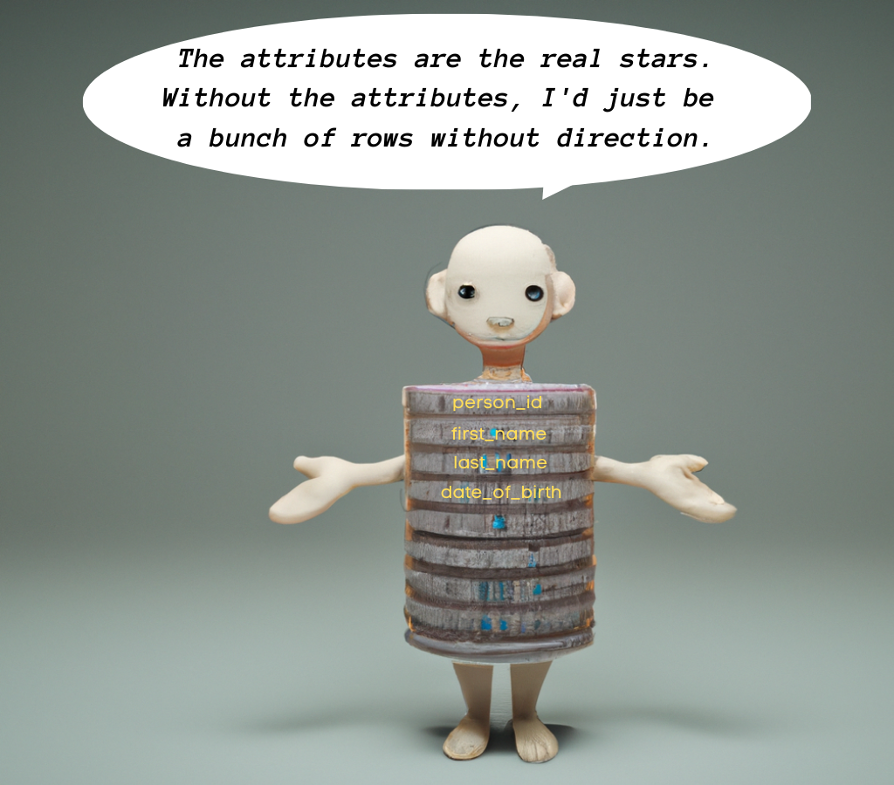
Adding Attributes

Slide 4
Adding Attributes Intro
We rely on one somewhat loose principle: add the attributes that support the data the organization needs based on how the database will be used.
We rely on analysis of the organization and on how the application will be used to know what attributes we need.
Adding attributes is much less structured than creating the entity and relationship structure.

Slide 5
Attributes are Physical
Adding attributes requires involved knowledge of how databases use data, and exactly what your specific database needs to store.
In contrast, the conceptual ERD only requires us to understand the organization and database usage at a higher level.
Adding attributes is an iterative process and requires paying attention to specific details.

Slide 6
Driving Questions
What fields do the use cases require?
What fields are obvious for my entities?
What fields do other similar applications and databases store?
What fields are unique for my database?
What would be presented on a user interface that uses my database?

Slide 7
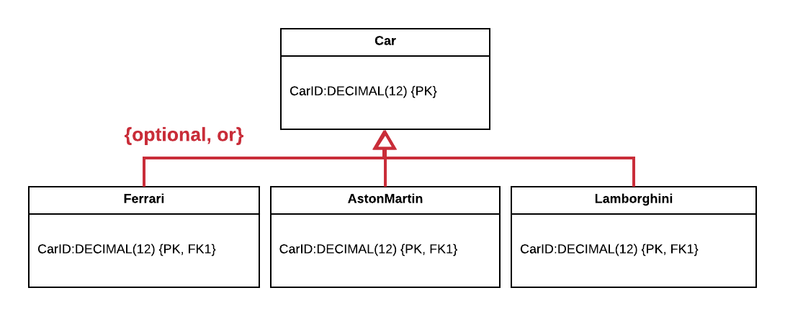
Car EERD for Reseller

Slide 8
Car Example First Questions
Question | Reasoning
What fields do other similar applications and databases store? What fields are obvious for my entities? | Based upon my experience with websites such as http://kbb.com, http://cars.com, and many others, there are many obvious fields we need to store. I visited these sites to refresh my memory. We need to store a VIN number and a price for each car, of course. We need to store a make and a model. We need to store car mileage because customers will want to know. We need to store color as well. These are the basic attributes any reseller would need. If I could meet with the reseller the database is for, I would likely come up with more fields, but for now I’ll stick with these basic ones.

Slide 9
Car Example Last Questions
What fields are unique for my database? | I looked up information on the Ferrari, Aston Martin, and Lamborghini lines. All three lines have V12 engine options, something not found in usual cars. Some Lamborghinis have auto-dimming side mirrors, which automatically adjust dimming to avoid glare, especially at night. Some Aston Martins offer tri-camera rearview mirrors to see middle, left, and right all in the rearview mirror (which also offers auto-dimming). Some Ferraris offer flat-plane engine designs to give a natural, smooth revving sound that is distinct to Ferraris.
What would be presented on a user interface that uses my database? | I did not identify any additional fields from this question beyond what I have already included.

Slide 10
Datatypes Must Be Selected
We must carefully select the datatype for each attribute, so that it will support storage of the data that will be in each field.
Selecting the correct datatypes can take some research and time.
Typical datatypes are VARCHAR for strings, DATE for dates (and basic time), and DECIMAL for numbers. Highly precise time datatypes are database dependent.
Scale and precision also matters for some datatypes.

Slide 11
Car Attributes Example
Attribute | Datatype | Reasoning
VIN | VARCHAR(17) | A quick web lookup reveals that VIN numbers are 17 characters in length. Also, VIN numbers are a combination of numbers and uppercase characters. So I use a VARCHAR(17) to support this attribute.
Price | DECIMAL(8,2) | Even these expensive cars will not cost more than $999,999, so, I allow for 6 digits. Due to the prices of these cars, it is unlikely the reseller would like to use decimal points in their prices such as $99,999.99; however, I cannot say for sure, so I allow for the standard two points after the decimal.
Color | VARCHAR(64) | I use VARCHAR(64) for color just in case there is a really long color name I am not aware of. Since VARCHAR does not take up storage for unused characters, this will not harm the database. I can see that the colors will be duplicated in this attribute, so this would be normalized out of the table during normalization, but in this part of the design it is in the table as is.
Make | VARCHAR(64) | The same as with Color, I use VARCHAR(64) in case there is a long make name.
Model | VARCHAR(64) | I use VARCHAR(64) here in case there is a long model name.
Mileage | DECIMAL(7) | While it’s unlikely any car being sold will have over 999,999 miles, I allow for 7 digits just in case.

Slide 12
Subtype Attributes Example
Subtype | Attribute | Datatype | Reasoning
All | IsV12Engine | CHAR(1) – Oracle BIT – SQL Server BOOLEAN – Postgres | All three subtypes offer V12 engines in some of their lines. This field is a flag indicating whether or not the engine is a V12 engine or not.
Ferrari | IsFlatPlane | CHAR(1) – Oracle BIT – SQL Server BOOLEAN – Postgres | Some Ferraris offer flat-plane engine designs to give a natural, smooth revving sound that is distinct to Ferraris. This is a flag indicating whether or not the Ferrari’s engine has a flat-plane design or not.
AstonMartin | HasTriCamera | CHAR(1) – Oracle BIT – SQL Server BOOLEAN – Postgres | Some Aston Martins offer tri-camera rearview mirrors to see middle, left, and right all in the rearview mirror. This is a flag indicating whether or not the Aston Martin’s rearview mirror is tri-camera.
Lamborghini | HasAutoDimmingSide | CHAR(1) – Oracle BIT – SQL Server BOOLEAN – Postgres | Some Lamborghinis have auto-dimming side mirrors, which automatically adjust dimming to avoid glare, especially at night. This is a flag indicating whether or not the Lamborghini’s side mirrors are auto-dimming.

Slide 13
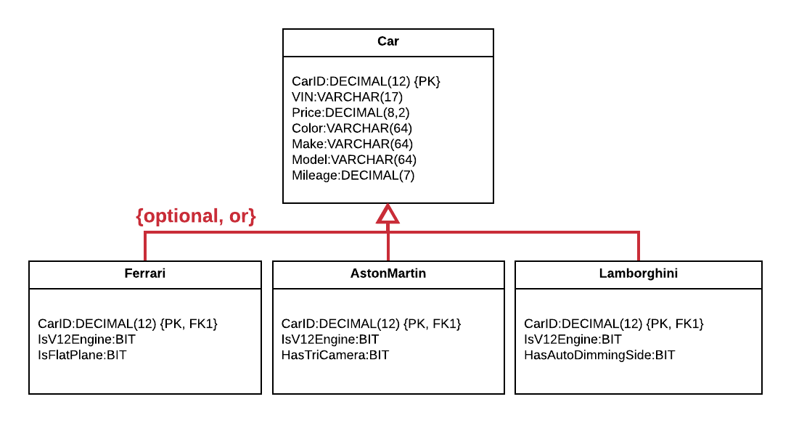
Car EERD with Attributes

Slide 14
Tables and Constraints

Slide 15
But First, SQL Scripts
A SQL script is simply a text file with a “.sql” extension at the end of the filename.
It’s best practice to save your code in SQL scripts so that you can rerun the code anytime you need.

Slide 16
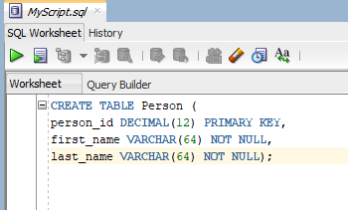
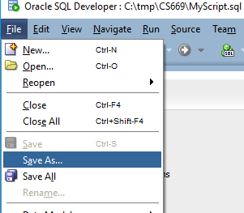
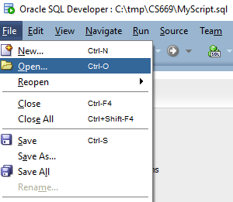
Using Scripts - Oracle
Type
Save
Open

Slide 17
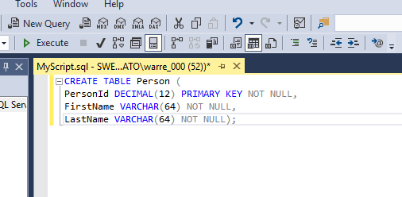
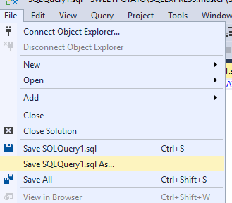
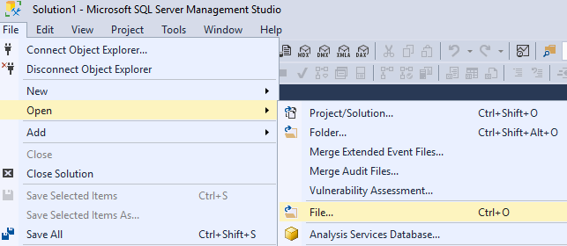
Using Scripts – SQL Server
Type
Save
Open

Slide 18
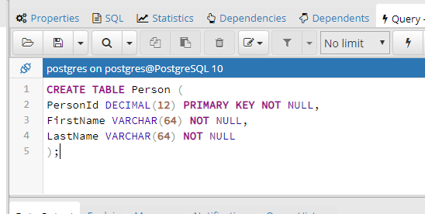
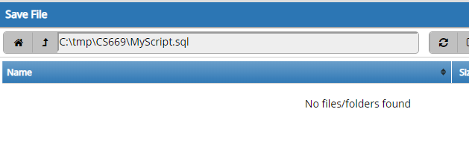
Using Scripts - Postgres
Type
Save
Open

Slide 19
Creating Tables from DBMS Physical ERD
It is straightforward to create the tables needed from a DBMS physical ERD. The entities and attributes in the ERD are created in SQL as tables and columns, one-for-one.
Since the ERD already contains the attributes, datatypes, and constraints, creating the tables is a mostly mechanical process.

Slide 20
Car EERD with Attributes (Again)

Slide 21
Car Create Table Examples
CREATE TABLE Car (
CarID DECIMAL(12) NOT NULL PRIMARY KEY,
VIN VARCHAR(17) NOT NULL,
Price DECIMAL(8,2) NOT NULL,
Color VARCHAR(64) NOT NULL,
Make VARCHAR(64) NOT NULL,
Model VARCHAR(64) NOT NULL,
Mileage DECIMAL(7) NOT NULL);
CREATE TABLE Ferrari (
CarID DECIMAL(12) NOT NULL PRIMARY KEY,
IsV12Engine BIT NOT NULL,
IsFlatPlane BIT NOT NULL,
FOREIGN KEY (CarID) REFERENCES Car(CarID));
Notes:
We use the entity name “Car” for the table name, and then create columns that are one-to-one matches of the entity’s attributes.
We add the primary key constraint to CarID as indicated, and NOT NULL to the attributes we know should not be null (which for this table is all attributes).
Notice that the CREATE TABLE statement for Ferrari has a one-to-one mapping with its entity definition in the ERD, including the primary and foreign key constraints.

Slide 22
Tips About Your Script
Make sure to add tables in the correct order. A referenced table must be added before a referencing table. Alternatively, foreign key constraints can be added with ALTER TABLE commands; then the creation order doesn’t matter.
Save a single script with all of your table and constraint creations.
Add DROP TABLE commands at the top the script for all tables (in the correct order) so you can run your script over and over again as you modify it.

Slide 23
Normalizing Your Entities

Slide 24
Normalization Introduction
Normalization is the universally accepted method of reducing data redundancy.
Normalization works by identifying dependencies between database columns and eliminating unwanted dependencies.
When a table is normalized, it may result in additional tables.
It is normal practice to normalize tables for operational databases.

Slide 25
Where Normalization Fits
Once a conceptual ERD is mapped to a DBMS physical ERD, and attributes are added, normalization is the last step necessary before implementation in SQL.
We want to normalize our entities before they are implemented in SQL because the changes would be more expensive otherwise.
While normalization is performed on the DBMS physical ERD, it affects the conceptual ERD as well as the structural database rules.
It’s important to keep the structural database rules, conceptual ERD, and DBMS physical ERD in sync.

Slide 26
Normal Forms
Normalized tables are known by their “normal form”.
Each normal form eliminates a new form of redundancy.
1NF ensures the table is valid.
2NF eliminates partial dependencies.
3NF eliminates transitive dependencies.
BCNF eliminates every problematic single-valued dependency.

Slide 27
Functional Dependency
A functional dependency is written as A → B.
A is one set of values (technically, a domain), and B is a set of values.
Technical description: When A → B, there exists a deterministic function that maps every value in A to a value in B.
Casual description: When A → B, the value of B is derived from A, for all values of A.

Slide 28
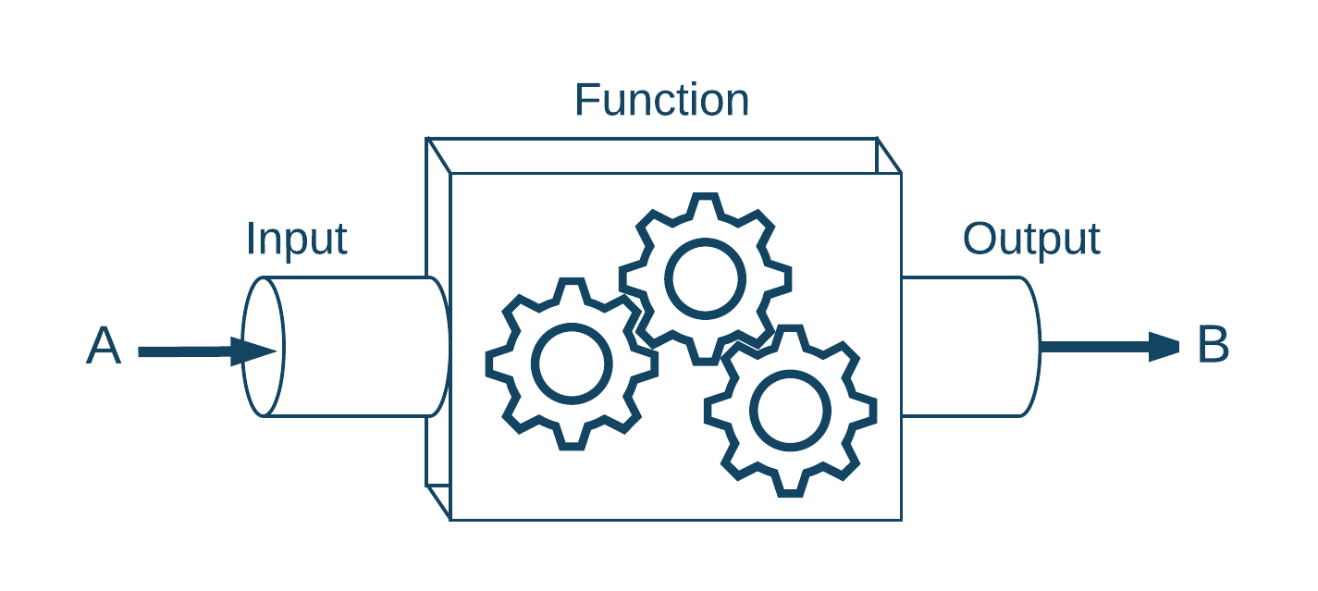
General Function

Slide 29
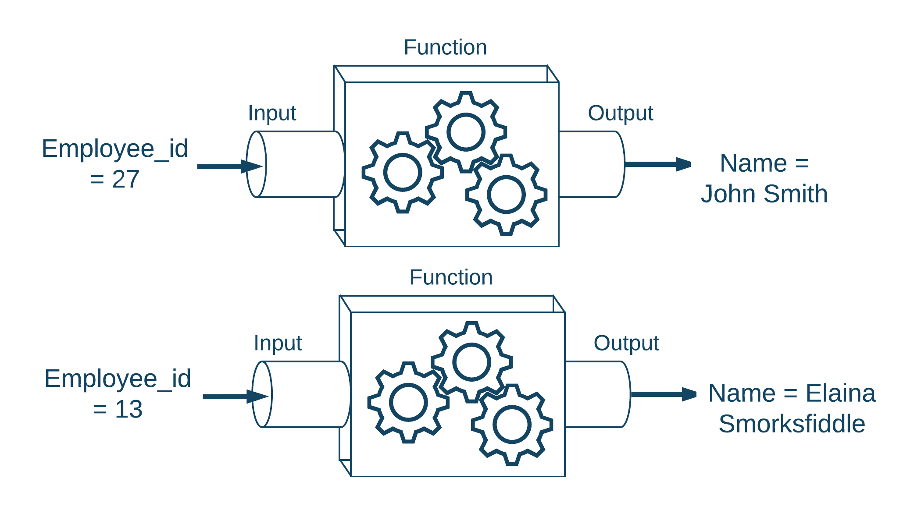
Application to Relational Design

Slide 30
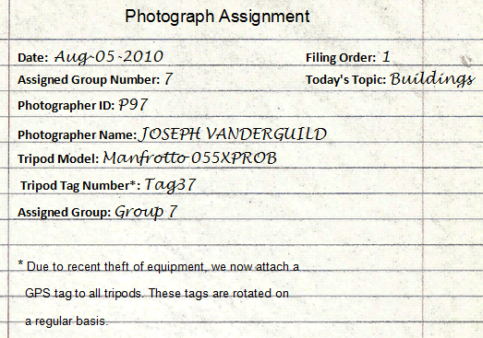
Photography Agency Assignments
Notes:
Each photographer is assigned an ID to facilitate filing and locating cards.
Every day groups are formed and photographers are assigned to these groups.
Groups can be formed several times a day, and a photographer can be assigned to multiple groups in a day.
Every day the photography agency chooses a different focus, for example “Buildings” or “Trees”.
Each group checks out one or more tripods for their excursion.
Due to recent theft of equipment, GPS tags are attached to tripods, and are rotated on a regular basis. On any given day, the tripod tag stays with one tripod, but the tag may be changed on a different day.
All assignments are kept on file.
Each file is given a number called a “Filing Order”, beginning with the number 1 each day, so that the files can be filed first by date, then by the filing order number.

Slide 31
Step 1: Convert to a Table

Slide 32
Sidebar: UNF
In Unormalized Normal Form, a table contains one or more repeating groups (Connolly & Begg), which means that there is more than one value in any cell.
For example, a UNF conversion is below.

Slide 33
Requirements for 1NF
There must be only one value in each cell (no repeating groups).
Notes:
Note that older definitions required a primary key, but we have since learned primary keys are not required for tables.

Slide 34
Step 2: Identify Functional Dependencies
date ➔ todays_topics
date,filing_order ➔ all attributes (candidate key)
date,tripod_tag_number ➔ tripod_model
photographer_id ➔ photographer_name

Slide 35
Step 3: Identify Candidate Keys
We must identify all candidate keys, because the definition of normal forms 2NF, 3NF, and BCNF depend upon this.
In this case, we only have the combination of date and filing order as the one candidate key.
Note that not all relational tables have a candidate key.
If a table does not have a candidate key, once it is in 1NF, it is also in 2NF and 3NF (but not necessarily BCNF).

Slide 36
Step 4: Identify Partial Dependencies
A partial dependency can be of the form: A,B➔C,D B➔C
Note that A,B must be a candidate key to qualify as a “partial” dependency. If determinant is not a candidate key, 2NF is not concerned with it.
The table contains a partial dependency: date,filing_order➔all attributes date ➔ todays_topic
This partial dependency means that once we know the date, we also know that day’s topic.

Slide 37
Step 5: Removing Partial Dependencies
A new table is created which contains the determinant and the determined attributes.
The determinant also remains in the original table, but the determined attributes do not (copy the determinant, moved the determined.
In this example, since date ➔ todays_topic, date and todays_topic are moved into their own table, and date remains in the original table.

Slide 38
Requirements of 2NF
The table must be in 1NF.
The table must contain no partial dependencies.

Slide 39
Step 6: Identify Transitive Dependencies
In a transitive dependency, A ➔ B ➔ C.
Tables with transitive dependencies may still suffer from update anomalies.
Example:
If it rains, the ground is wet.
If the ground is wet, it is muddy.
RAIN ➔ WET_GROUND ➔MUD

Slide 40
Transitive Dependency
What if the agency needs to update Elizabeth Jaskolka’s name to “Elizabeth Harmon”, but only updates one copy?

Slide 41
Step 7: Remove Transitive Dependencies
Recall the functional dependency: photographer_id ➔ photographer_name
The transitive dependency in this example is: date,filing_order ➔ photographer_id ➔ photographer_name
Just as with 2NF, we create a new table, copy the determinant, and move the determined to the new table.

Slide 42
Transitive Dependencies Removed

Slide 43
Requirements of 3NF
A table in 3NF must first meet all requirements for 2NF.
The table must not have transitive dependencies.

Slide 44
More Data Redundancy
This example has a determinate which is not a candidate key: What if the agency realizes the model for “055XPROB” should be “049X”, but only updates one copy?
This kind of problem stems from determinants which are not candidate keys.

Slide 45
Step 8: Identify Non-Candidate Determinants
This example has a determinate which is not a candidate key: date,tripod_tag_number ➔ tripod_model

Slide 46
Step 9: Remove Non-Candidate Determinants
To remove this data redundancy, pull out the determinant and the determined into its own table, and also leave the determinant in the original table.

Slide 47
Moving to BCNF
It is not mandatory to go through 2NF and 3NF to move to BCNF.
In your project iteration, simply apply the rule “every determinant must be a candidate key” repeatedly, extracting items to a new table, until the normalization is complete.
This rule will also eliminate partial and transitive dependencies.

Slide 48
Attribute Evaluation
Aspect | What it Means | A+ Excellent
Sufficiency of Attributes (15%) | This measures how essential the attributes are to the needs of the database, the coverage (thoroughness) of the attributes, and how well justified the attributes are with explanations. Excellent solutions define important attributes for all entities, and are well justified. | Entirely essential Full coverage Well justified
Attribute Datatypes (10%) | This measures how appropriate the datatypes are for the needs of the data. Excellent attributes are entirely appropriate for the needs of the data, and have entirely appropriate precision, scale, and other limits. | Entirely appropriate
Attribute Naming (10%) | This measures how appropriate the attribute names are given their purpose, and how usable the names are in modern relational databases. Excellent names identify their purpose very well, and have only characters that can legally be used in a modern relational database. | Entirely appropriate Entirely usable

Slide 49
DBMS Physical ERD Evaluation
Aspect | What it Means | A+ Excellent
DBMS Physical ERD Quality (30%) | This measures how accurately the DBMS physical ERD represents the database design, and the correctness of the diagrammatic notation. Excellent DBMS physical ERDs accurately map all entities, relationships, and relationship constraints, enforce relationships properly with primary and foreign keys, contain all designed attributes and datatypes, and contain entirely correct diagrammatic notation throughout. | Entirely accurate Entirely correct
Normalization (10%) | This measures how well the tables are normalized. In an excellent solution, every table is either normalized to BCNF, or consciously normalized to a lesser normal form with excellent justification. | Excellent normalization

Slide 50
Script and Overall Evaluation
Aspect | What it Means | A+ Excellent
SQL Script Quality (15%) | This measures how accurately the SQL script implements the designed database structure, and the correctness of the SQL syntax. With excellent scripts: o the SQL script includes the table names, attribute names, attribute datatypes, and constraints exactly as defined in the DBMS physical ERD, as well as the identified sequences. o only designed elements are present in the script. o the syntax of the SQL script is entirely correct and could be executed in a modern relational database without modification | Entirely accurate Entirely correct
Prior Work Soundness (10%) | This measures how well any issues from prior iterations have been improved in order to provide a frame of reference for this iteration. | Completely improved or No improvement necessary

Slide 51
Reminder: Number of Entities
At least 10 entities are required at the conceptual level.
This means the structural database rules and conceptual ERD should have at least 10 entities.

Slide 52
References
Connolly, T & Begg, C. (2010). Database Systems. A Practical Approach to Design, Implementation, and Management.Business Database Systems. Boston: Pearson Education.

Slide 53

End

